Slide 1

WELCOME TO dbatools and Power BI walked into a bar - ABSTRACT
Going into a new shop and don't know the environments can be intimidating. The current DBA team/client just throws a list of instances where you should
have access and want you to do magic!
Fortunately we can leverage the dbatools PowerShell module to get whole bunch
of information that will give us a state of the art and help to answer some questions.
Is this instance running on a virtual server or bare-metal?
What resources (CPU/Memory) are allocated?
Which version and edition is installed?
What is the size evolution of my database, filegroup or table?
Do you know how many records the biggest table is growing by every day?
What will a forecast tell you about your database/file group/table size in 2 months? will you need more space?
I will show how you can save the information gathered by dbatools on a central database. On top of that, how can you leverage from a couple of Power BI dashboards that I have created. This dashboard will help you answer these and other questions faster than you thought it would be possible. This is an 100% free solution! Having data and give it meaning is priceless and after this session you will be able to implement this on your site and share it with you teammates, clients and managers!

Slide 2



and walked into a bar
Cláudio Silva - SQL Server DBA & PowerShell lover

Slide 3


















Sponsored by
Notes:
Please add this slide at the beginning of your presentation

Slide 4


Cláudio Silva
MS SQL Server DBA
Working with MS SQL Server since version 2000
PowerShell Lover
Community
Major contributor on dbatools (http://dbatools.io) and dbachecks (http://dbachecks.io) PowerShell open source projects

Slide 5
Agenda
Pre-requirements
Pre-configurations
Which questions I want to see answered?
Scripts development and some caveats
Implementation approach
Saving data to SQL Server
Database structure – Code - Power BI dashboard
FAQ

Slide 6
Pre-requirements
Decide where it will be running
- Normally a centralized server where you can reach all other servers/instances.
dbatools module installation
- Without internet access?
- Save the module using Save-Module cmdlet and copy it to the server
- With internet access
- Install-Module –Name dbatools
Install Power BI desktop.
Is free.
Download it from https://www.microsoft.com/en-us/download/details.aspx?id=45331
Install on any computer where you can access your central SQL Server instance.
Notes:
Dbatools module:
- Minimum PS v3.0 recommended PS 5.1
- Copy it to
- PowerShell module directory (recommended and we will see why later):
- C:\Program Files (x86)\WindowsPowerShell\Modules\
- Or, if you want just for a single account copy to:
- C:\Users\<account name>\Documents\WindowsPowerShell\Modules
Power BI Desktop
- It can be on your laptop. As long as you can reach the SQL Server central instance it’s ok
You can also leverage on SQL Server Power BI Report Server if you already have on in place (be aware because can have costs depending on your licensing)

Slide 7



Overview
DEV
Instance 1
Instance 2
Instance 3
QA
Instance 4
Power BI
Instance 5
Central Server
Instance 6
PROD
Instance 7
Instance 8
Instance 9
Notes:
Central server where scripts run
Collect data from instances
Power BI to visualize data

Slide 8
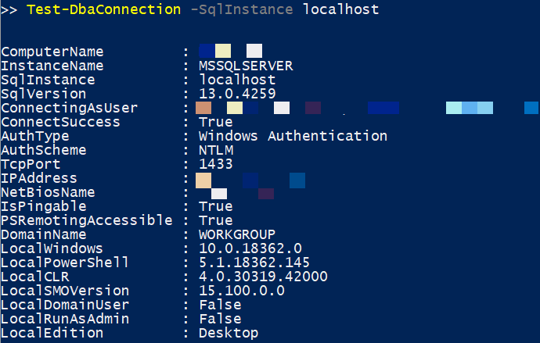
Pre-configurations
Can I take advantage of all dbatools’ features?
Firewall rules:
- SQL Server instance port (default 1433)
- UDP (default 1434)
- ICMP (Internet Control Message Protocol)
- DCOM (135)
- WinRM - PSRemoting (HTTP: 5985 and HTTPS: 5986) (Options like -UseSSL and -IncludePortInSpn can be (very) important.
Note: Take a look on my blog post related with the most recent configurable settings to increase PSRemoting coverage on dbatools - https://claudioessilva.eu/2019/08/20/more-powershell-remoting-coverage-in-dbatools/)
Testing and checking if we can have it all:
- Test-DbaConnection
Select the credential that will be running the jobs and test again with it:
- Test by opening a "run as" session or login from the central server with it.
Notes:
Dbatools has more than 500 commands and it leverage on:
- SQL Server
- PS Remoting
- WMI/CMI (for computer management)
- Registry
I work on a restricted environment where, by default when a new server born and SQL Server is installed there, my central instance don’t have access to it. To fix this I need to request the Firewall team to add my new IP (new SQL Server installation) to the group of rules where others already exists.
Different credential:
- Example: Ask for an AD account and add it to your SQL Server administration group that has access to your estate.
NOTE: Account must have logon privileges to be able to launch PS processes to run the scripts

Slide 9
Which questions I want to see answered?
Server data
- CPU / Memory? -> Get-DbaComputerSystem
SQL Server data
- Version / Edition -> Get-DbaInstanceProperty
- Tables size / number of records? -> Get-DbaDbTable
Both?
- Disk space -> Get-DbaDiskSpace
Need help?
- Use our docs web site docs.dbatools.io
- Or the Find-DbaCommand to search for the command that can answer your question.
Notes:
This will determine which dbatools commands we will use to gather information
Both
- Because it returns data related with both server and instance

Slide 10
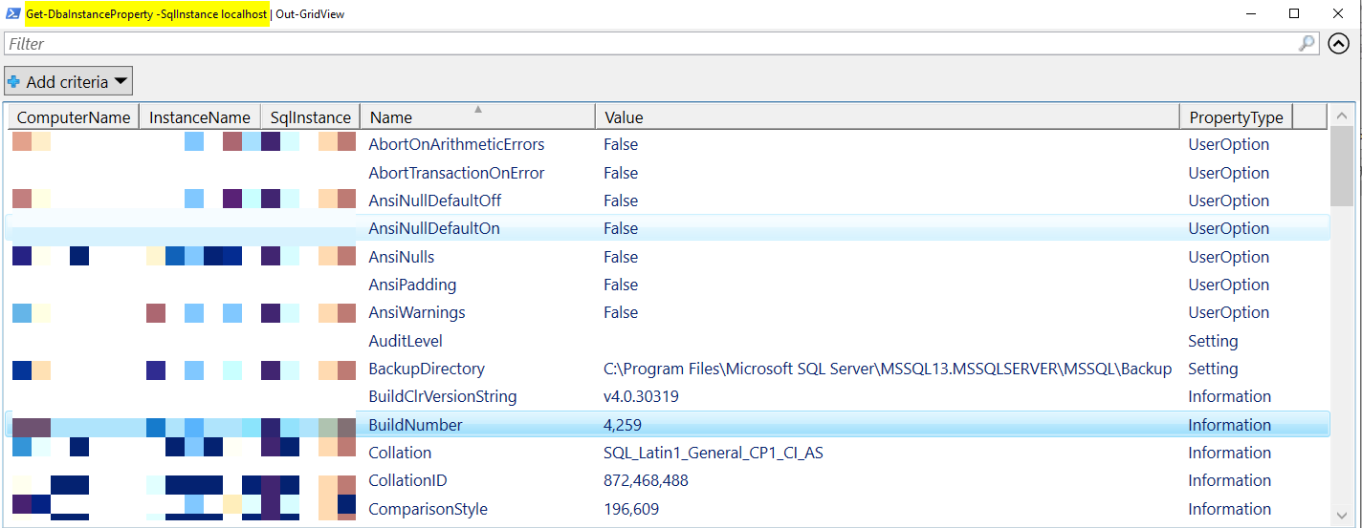

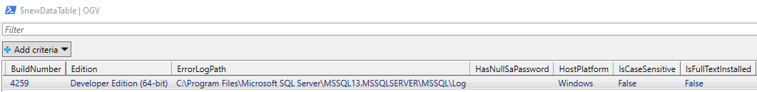
Scripts development and some caveats
Script Pattern
- Gathering the data will return PowerShell objects, then:
We add a ‘CollectionTime’ column with current datetime using Add-Member and
Pipe to Write-DbaDatatable to save the data to SQL Server table
Caveats
- Some commands may output the data in a different format. It’s a PowerShell object anyway but for instance just a key-pair value instead of “tabular” way. Ex: Get-DbaInstanceProperty
- Invoke-TransposeDataTable for the rescue. It’s a function that will rotate the PowerShell object and a key will become a column name and the value, the value for that column.
- Column order when using Write-DbaDataTable

Slide 11
Implementation approach
SQL Server Agent Jobs
- Request a dedicated domain account that has permission on all instances.
- Job owner should be your service account or use an SQL credential.
- Have a job with mutiple steps. Each one invokes one of this scripts.
- Find the best schedule to run it
Need help? – Follow the instructions @ https://dbatools.io/agent/
Suggestion:
- If you find that it takes too long to run, you may want to split it in more jobs to start in parallell.
Notes:
Answering the question…how it runs?
The account with permissions on all instances can belong to the custom admin group. That will be easier.
Suggestion
Or create a new script that will be responsible to split the work. The 1st approach is nicer if we want to leverage on Agent Job log

Slide 12
Saving data To SQL Server
Using Write-DbaDataTable
(Auto-)Generate tables
Check Datatypes - ex: nvarchar(max). Change them.
Create Clustered indexes!
Use compression! Available at any edition since SQL Server 2016 SP1.
Notes:
Write-DbaDbTableData has an –AutoGenerate paremeter that says, if the table don’t exists yet, infer the data types and create it. Howerver, I suggest tunning the datatypes after

Slide 13
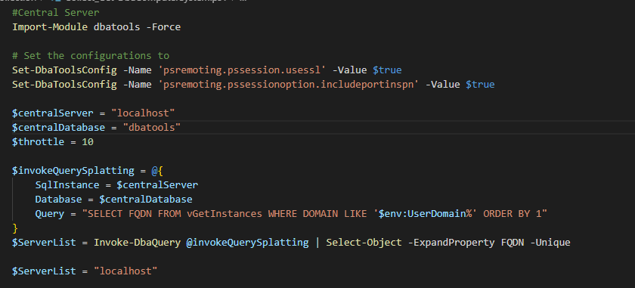
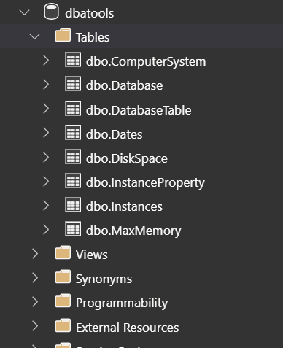
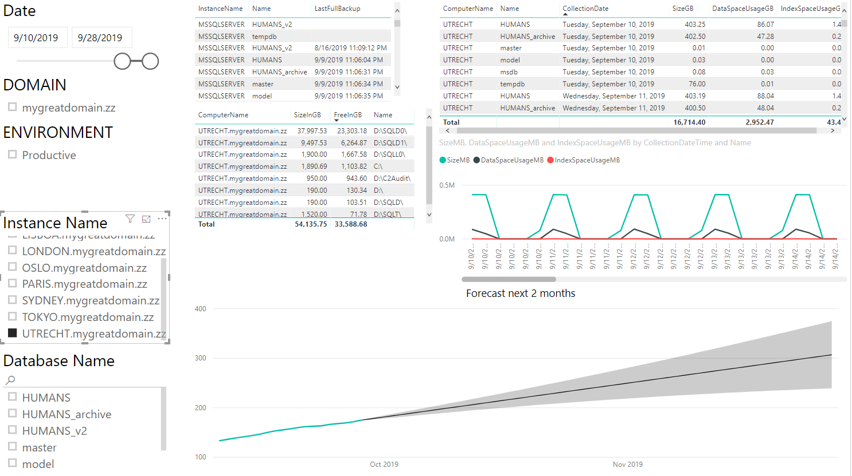
Database structure – Code - Power BI dashboard
Notes:
Write-DbaDbTableData has an –AutoGenerate paremeter that says, if the table don’t exists yet, infer the data types and create it. Howerver, I suggest tunning the datatypes after

Slide 14
FAQ
“What if…I don’t have a initial list of servers?”
“I have dozens of instances…” - Bigger environments / Multiple domains
“Does it just work with Windows Authentication?”
“What about maintenance? New versions of dbatools?”
Notes:
“What if…I don’t have a initial list of servers?”
You can leverage on Find-DbaInstance. Read the help carefully. This command can raise some flags by the security team.
“I have dozens of instances…” - Bigger environments / Multiple domains
Use PoshRsJob module from Boe Prox for multi-thread / throttling.
“Does it just work with Windows Authentication?”
The current way it is build yes. It fits for my needs so I started from there.
“But…what if I have a SQL Server running on a Linux host?”
It is already possible: https://docs.microsoft.com/en-us/sql/linux/sql-server-linux-active-directory-authentication
“What about maintenance? New versions of dbatools?”
- Save new version and copy or use Install-Module –Name dbatools –Force
- Test it!
Multi-thread
It cann be by Environment
- Example:
- Get-DbaComputerSystem -> Can be all at once (1 row per instance)
- Get-DbaDbTable -> Throttling by database (maybe the heavier we have)
“What about maintenance? New versions of dbatools?”
- You want to have a stable environment running. Even we don’t introduce a lot of breaking changes, for this scripts a breaking change can appear in a different way. Example: Not filtering the data or selecting the columns and the new version output more columns

Slide 15

Ask your Questions

Slide 16

Session Evaluation
Notes:
Please add this slide at the end of your presentation

Slide 17

Event Evaluation
Notes:
Please add this slide at the end of your presentation too if you are the last session of the day (16:00 to 16:45)

